Slide 1
Recipe Finder
Team No. 151
Vikram Singh
Giridhar Shanmugam
Harikishore Manday
Debdwaipayan Biswas
Date
Notes:
Title Slide
Project Name: The title of the AWS-based project.
Team Members: Names and roles of all team members.
Date: Presentation date.
1

Slide 2
Introduction
Core Objectives;
Ingredient input: Users list what ingredients they have.
Recipe database: A backend database with various recipes.
Matching algorithm: Finds recipes that can be made with listed ingredients.
User-friendly UI: Responsive and accessible design.
Technical Stack;
Frontend: React.js
Backend: Node.js and Express.js
Database: MongoDB
Hosting: Vercel
Recipe finder
2
Notes:
Introduction
Brief Outline: A summary of what the project is about.
Objectives: High-level goals to be covered in the presentation.
2

Slide 3
Project Objectives
User Convenience: Simplify meal preparation by matching available ingredients with suitable recipes.
Efficiency: Ensure fast and responsive user experience.
Intuitive Design: Provide a user-friendly and accessible interface.
Scalability: Build a system that can handle an increasing number of users and recipes.
Accurate Recipe Matching: Develop a reliable algorithm to find recipes based on user-inputted ingredients.
Recipe Finder
3
Notes:
Project Objectives
Goals: Specific milestones or deliverables.
Expected Outcomes: What the project aims to achieve.
3

Slide 4
Project Scope
Target Audience: Home cooks, food enthusiasts, and anyone looking to make meals with available ingredients.
Functionality: Users input ingredients, receive recipe suggestions, view recipe details, and save favorite recipes.
User Interface: Simple, intuitive, and accessible across devices.
Performance: Fast, reliable, and able to handle multiple users simultaneously.
Scalability: Easily expandable with more recipes and new features.
Security: Secure user data handling and protection.
Maintenance: Regular updates and improvements based on user feedback.
Project Name
4
Notes:
Project Scope
Statement: The project statement as provided by the instructor.
Scope Boundaries: What is and isn't covered by the project.
4

Slide 5
Individual Contributions
Member 1: Specific role and tasks performed.
Member 2: Specific role and tasks performed.
Member 3: Specific role and tasks performed.
Member 4: Specific role and tasks performed.
…
Project Name
5
Notes:
Individual Contributions
Member 1: Specific role and tasks performed.
Member 2: Specific role and tasks performed.
Member 3: Specific role and tasks performed.
Member 4: Specific role and tasks performed.
…
5

Slide 6
Key Concepts
MongoDB: This is used as the database to store data related to cuisines, recipes, or any other relevant information.
Express.js: It’s used as the backend framework to handle HTTP requests, define routes, and interact with the MongoDB database.
React: This JavaScript library is used for building the user interface (UI) components of the website. It handles the frontend presentation and user interactions.
Node.js: This serves as the runtime environment for executing JavaScript code on the server side, coordinating with Express.js, and facilitating communication with the MongoDB database.
Project Name
6
Notes:
Key Concepts
Features: Important AWS features utilized.
Services: Key AWS services employed and their significance.
6

Slide 7
Challenges and Solutions
User Engagement and retention Challenge: Ensuring consistent user interaction and return visits.
Solution: Implement social features, personalized recommendations, and notifications to keep users engaged.
Scalability and Performance Challenge: Managing increased traffic and maintaining site performance.
Solution: Use cloud hosting, optimize backend code and database queries, implement caching, and utilize CDNs for static content.
Security Challenge: Protecting user data and ensuring secure transactions.
Solution: Implement HTTPS, data encryption, secure authentication methods, regular updates, and security audits.
Data Management Challenge: Efficiently handling and updating large volumes of recipe and user data.
Solution: Utilize robust database management, optimize data processes, implement validation checks, and maintain backups.
Project Name
7
Notes:
Challenges and Solutions
Problem 1: Description and resolution.
Problem 2: Description and resolution.
7

Slide 8
Challenges and Solutions
Mobile Optimization:
Challenge: Providing a seamless experience across various mobile devices.
Solution: Develop a responsive design, test across devices, consider PWAs for offline access, and ensure performance optimization.
Content Quality and Variety:
Challenge: Offering diverse and high-quality recipe content.
Solution: Encourage UGC, collaborate with chefs or bloggers, curate content, and integrate nutritional information.
Monetization:
Challenge: Finding sustainable revenue streams without compromising user experience.
Solution: Explore premium subscriptions, affiliate marketing, sponsored content, and targeted advertising.
Regulatory Compliance:
Challenge: Adhering to data privacy laws and regulations.
Solution: Stay compliant with GDPR, CCPA, and other regulations, implement privacy policies, obtain user consent, and provide data management tools.
8

Slide 9
Lessons Learned
Technical Insights: Useful insights about the working of the website development framework was implemented after through understanding.
Process Insights: Regular team meetings and slack communication tools were instrumental in maintaining project success by ensuring clear consistent communication amoung team members
Integration challenges: The integration of MERN stack, including MongoDB, Express.js, React.js and Node.js, highlighted the need for the understanding dataflow between frontend and backend , resolving initial issues.
Project Name
9
Notes:
Lessons Learned
Technical Insights: What was learned technically.
Process Insights: What was learned about team collaboration.
9

Slide 10
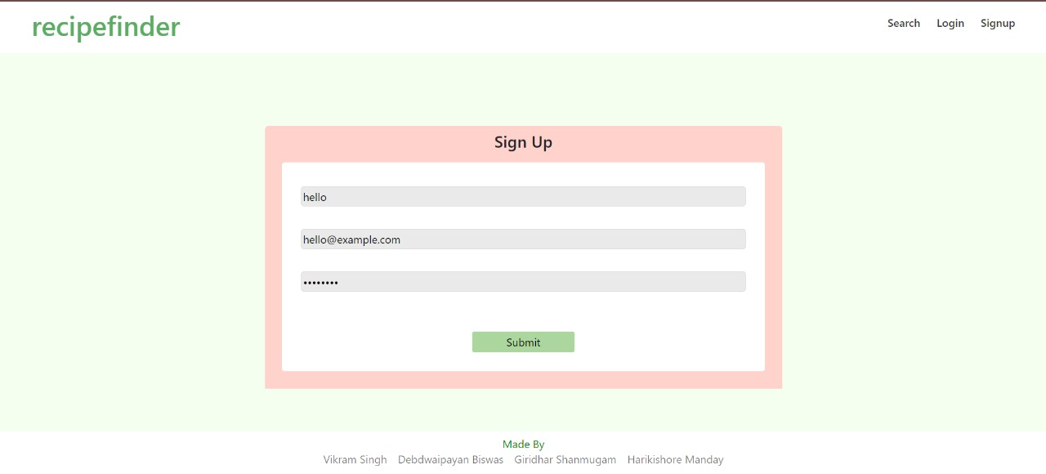
Screenshots
Screen Captures:
Sign up page: The sign up page would be required to be filled by the new users to use the services. The user would be required to register using a username, email ID and set a password we would be used to access into the website.
Project Name
10
Notes:
Screenshots
Screen Captures: Visual snapshots to showcase key elements.
Context: Description explaining what the screenshot represents.
10

Slide 11
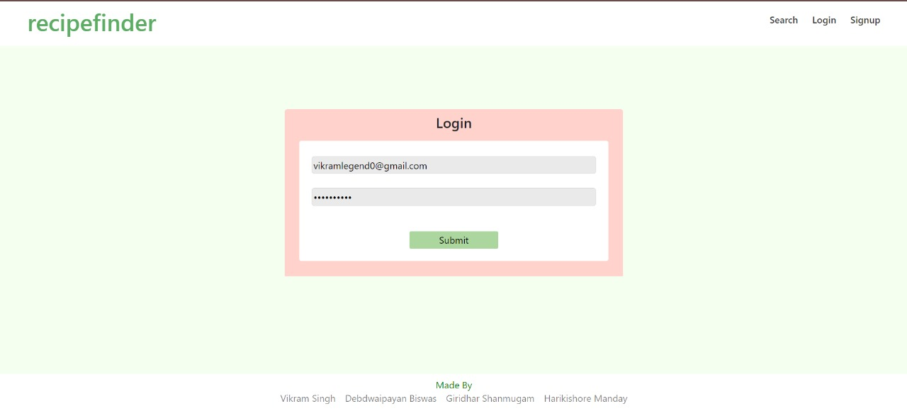
Screenshots
Login Page: If the user is already registered then he/she has to login into the site using the email ID and password used for account creation during registration.
Project Name
11
Notes:
Screenshots
Screen Captures: Visual snapshots to showcase key elements.
Context: Description explaining what the screenshot represents.
11

Slide 12
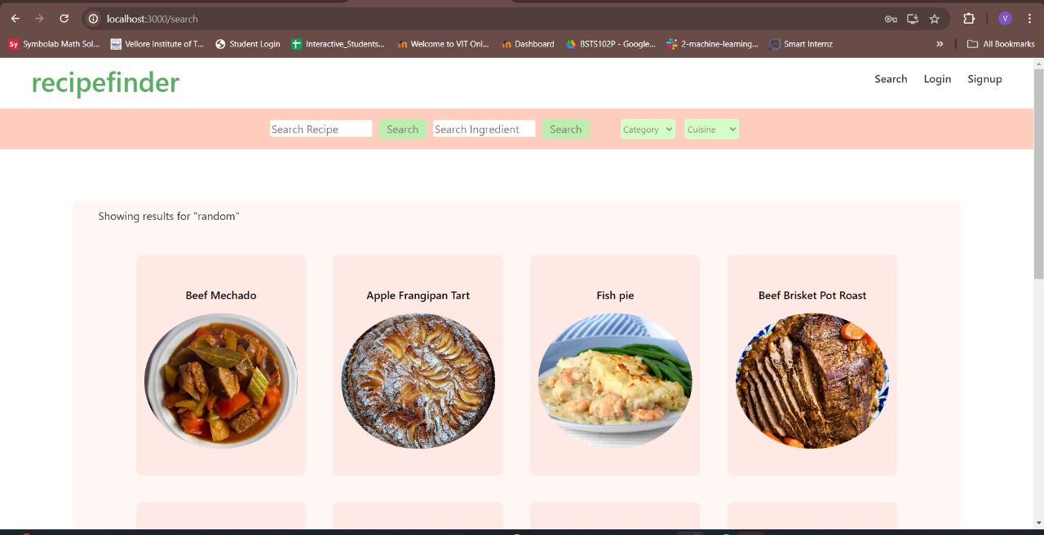
Screenshots
Home Page: The home page gives smart recommendation based on the previous searches made by the user and the user would be able to search for particular recipes by providing name of dish.
Project Name
12
Notes:
Screenshots
Screen Captures: Visual snapshots to showcase key elements.
Context: Description explaining what the screenshot represents.
12

Slide 13
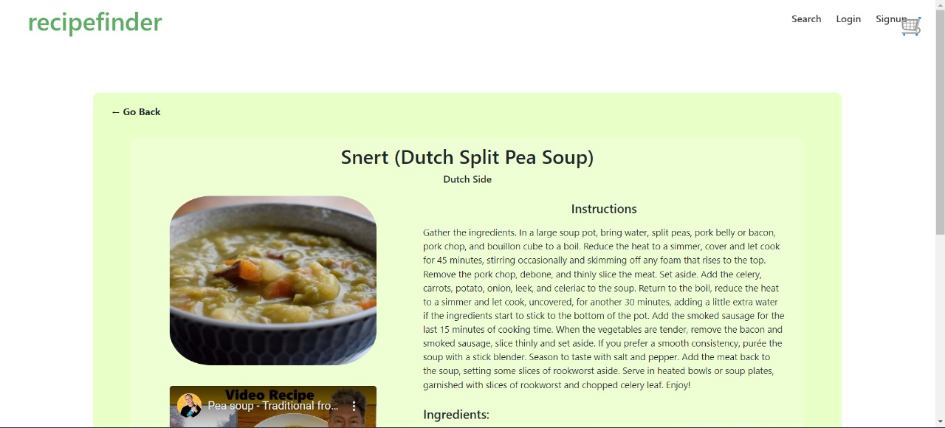
Screenshots
Result page: The result page shows the result dish that has been requested by the used along with the ingredients list required to make the dish.
Project Name
13
Notes:
Screenshots
Screen Captures: Visual snapshots to showcase key elements.
Context: Description explaining what the screenshot represents.
13

Slide 14
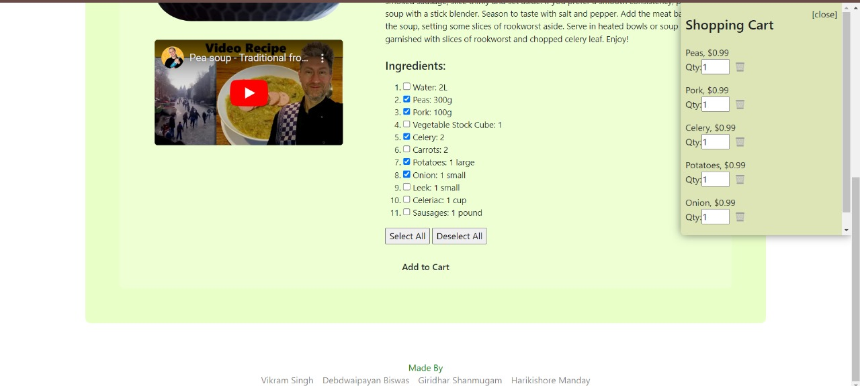
Screenshots
Result page: The result page also has a video attached that shows the steps to make the particular dish and the ingredients list from which we can choose to buy the ingredients.
Project Name
14
Notes:
Screenshots
Screen Captures: Visual snapshots to showcase key elements.
Context: Description explaining what the screenshot represents.
14

Slide 15
Future Scope
User Authentication and Profiles: Enable signup, login, and user profiles for personalization and interaction.
Social Features: Introduce comments, ratings, and reviews for recipes to enhance user engagement.
Advanced Search and Filtering: Improve search with filters (e.g., by ingredients, cuisine type) for better recipe discovery.
Recipe Recommendations: Use machine learning for personalized recipe suggestions based on user preferences.
Mobile Optimization: Ensure the website is responsive and user-friendly on mobile devices.
Project Name
15
Notes:
Future Scope
Improvements: Potential updates or add-ons.
Next Steps: Future phases or expansions.
15

Slide 16
Future Scope
API Integration: Integrate with external APIs for nutritional info, ingredient sourcing, etc., to enrich content.
Monetization Strategies: Explore revenue streams like partnerships, premium features, or targeted ads.
Offline Mode: Implement capabilities for users to access saved recipes offline or as a Progressive Web App (PWA).
Internationalization: Support multiple languages and localize recipes for global appeal.
Analytics: Use analytics tools to track user behavior, popular recipes, and trends for continuous improvement.
16

Slide 17
Questions
Questions: Opening the floor for any questions from the audience.
Project Name
17
Notes:
Q&A
Questions: Opening the floor for any questions from the audience.
17

Slide 18
Thank You!
Team No. 151
Vikram Singh
Giridhar Shanmugam
Harikishore Manday
Debdwaipayan Biswas
18
Notes:
Thank You
Acknowledgments: Thanks to those who contributed.
Contact Info: How to reach the team for further queries.
18

Slide 19
Live Demo
Live Walkthrough: On-the-spot demo of the project.
Highlighting a particular use case where the project could be applied.
Project Name
19
Notes:
Live Demo
Demonstration: Real-time showcase of the project's functionality and features.
A specific example or scenario illustrating the project in action.
19

Slide 20
Color Theme
Typography
Calibri
Calibri Light
Notes:
20

